Slide 1
Chapter 4 Physics of Bipolar Transistors
4.1 General Considerations
4.2 Structure of Bipolar Transistor
4.3 Operation of Bipolar Transistor in Active Mode
4.4 Bipolar Transistor Models
4.5 Operation of Bipolar Transistor in Saturation Mode
4.6 The PNP Transistor

Slide 2
Bipolar Transistor
In the chapter, we will study the physics of bipolar transistor and derive large and small signal models.
CH4 Physics of Bipolar Transistors

Slide 3
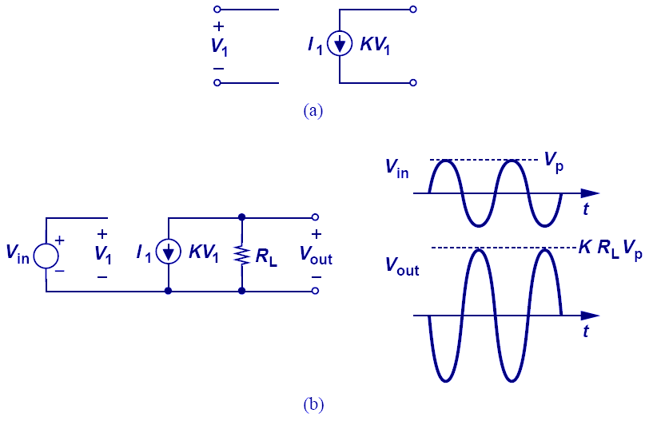
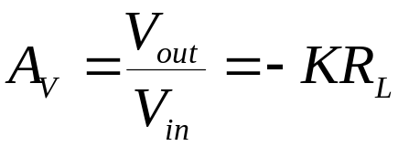
Voltage-Dependent Current Source
A voltage-dependent current source can act as an amplifier.
If KR_{L} is greater than 1, then the signal is amplified.
CH4 Physics of Bipolar Transistors

Slide 4
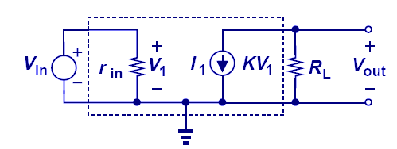
Voltage-Dependent Current Source with Input Resistance
Regardless of the input resistance, the magnitude of amplification remains unchanged.
CH4 Physics of Bipolar Transistors

Slide 5
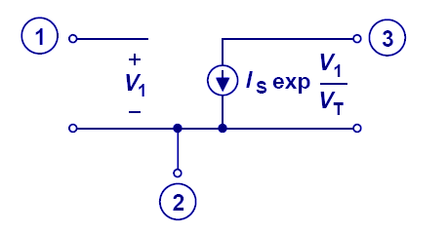
Exponential Voltage-Dependent Current Source
A three-terminal exponential voltage-dependent current source is shown above.
Ideally, bipolar transistor can be modeled as such.
CH4 Physics of Bipolar Transistors

Slide 6
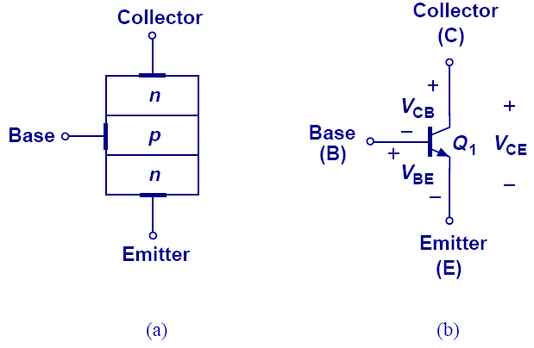
Structure and Symbol of Bipolar Transistor
Bipolar transistor can be thought of as a sandwich of three doped Si regions. The outer two regions are doped with the same polarity, while the middle region is doped with opposite polarity.
CH4 Physics of Bipolar Transistors

Slide 7
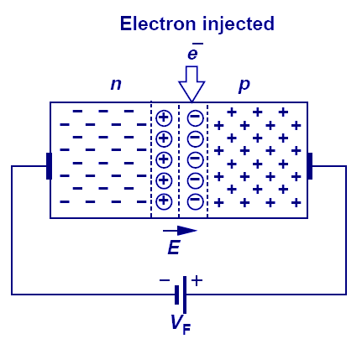
Injection of Carriers
Reverse biased PN junction creates a large electric field that sweeps any injected minority carriers to their majority region.
This ability proves essential in the proper operation of a bipolar transistor.
CH4 Physics of Bipolar Transistors
Notes:
The voltage here actually forward bias the PN junction, and there’s no 4.6a), just 4.6.

Slide 8
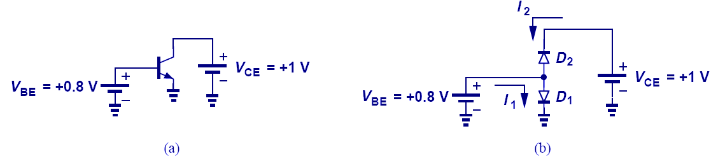
Forward Active Region
Forward active region: V_{BE} > 0, V_{BC} < 0.
Figure b) presents a wrong way of modeling figure a).
CH4 Physics of Bipolar Transistors

Slide 9
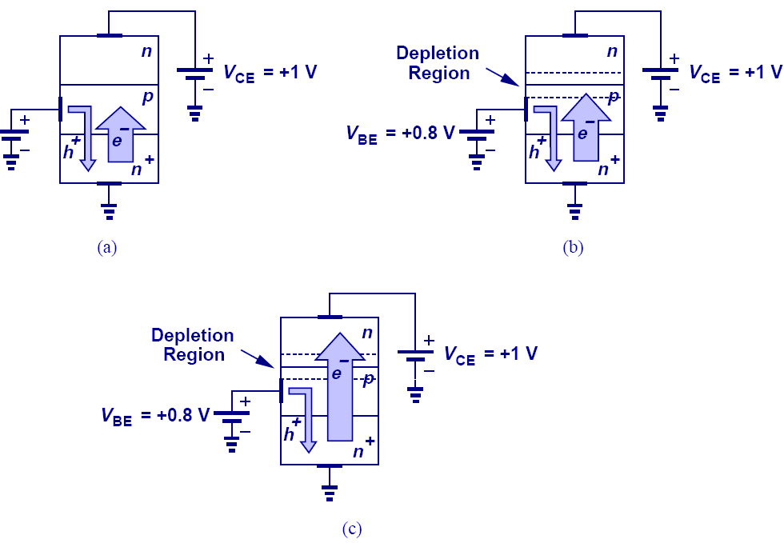

Accurate Bipolar Representation
Collector also carries current due to carrier injection from base.
CH4 Physics of Bipolar Transistors

Slide 10
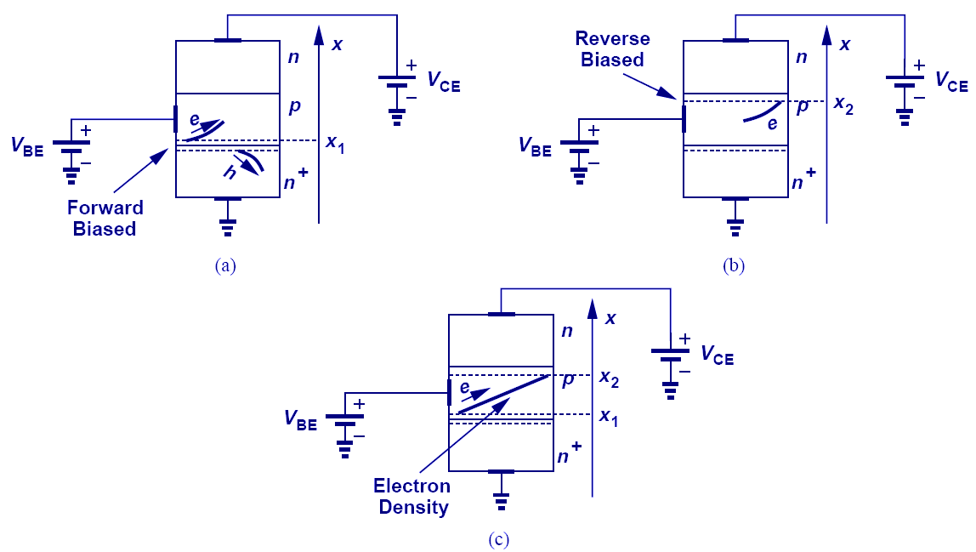
Carrier Transport in Base
CH4 Physics of Bipolar Transistors

Slide 11
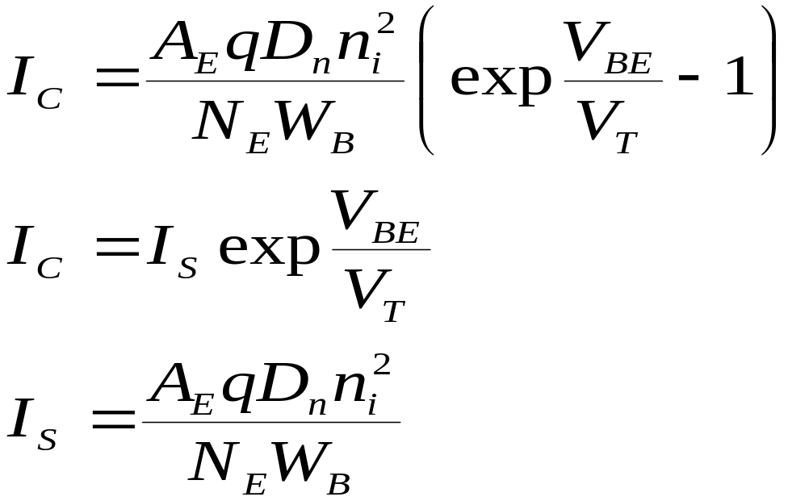
Collector Current
Applying the law of diffusion, we can determine the charge flow across the base region into the collector.
The equation above shows that the transistor is indeed a voltage-controlled element, thus a good candidate as an amplifier.
CH4 Physics of Bipolar Transistors

Slide 12
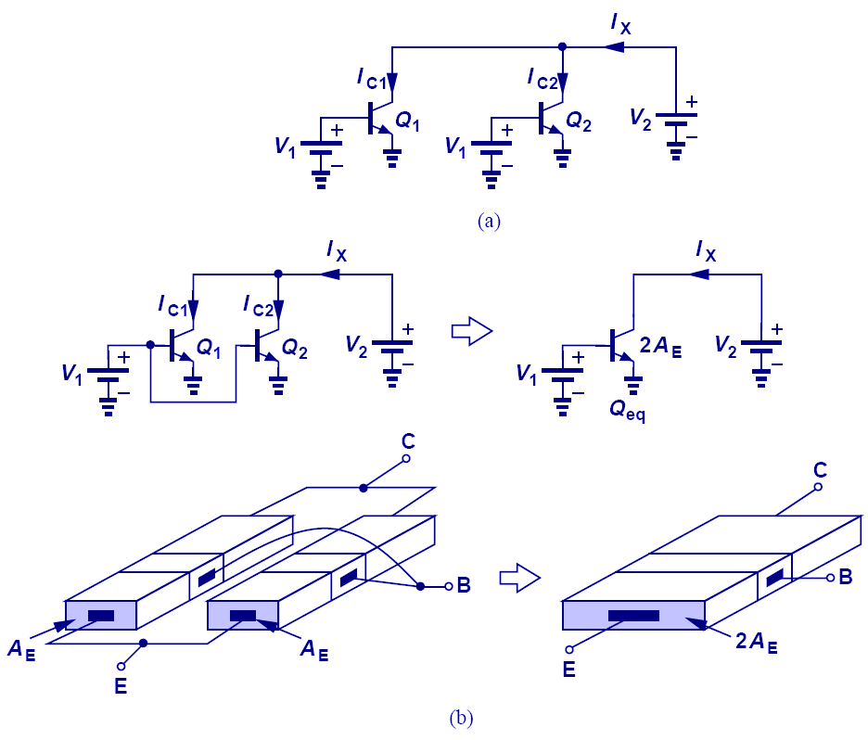
Parallel Combination of Transistors
When two transistors are put in parallel and experience the same potential across all three terminals, they can be thought of as a single transistor with twice the emitter area.
CH4 Physics of Bipolar Transistors

Slide 13
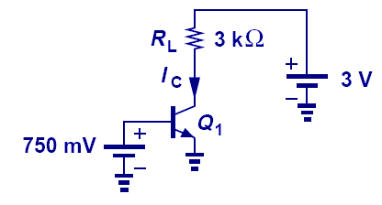
Simple Transistor Configuration
Although a transistor is a voltage to current converter, output voltage can be obtained by inserting a load resistor at the output and allowing the controlled current to pass thru it.
CH4 Physics of Bipolar Transistors

Slide 14
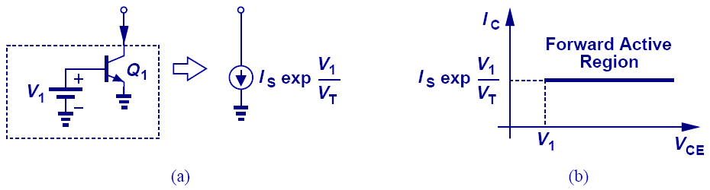
Constant Current Source
Ideally, the collector current does not depend on the collector to emitter voltage. This property allows the transistor to behave as a constant current source when its base-emitter voltage is fixed.
CH4 Physics of Bipolar Transistors

Slide 15
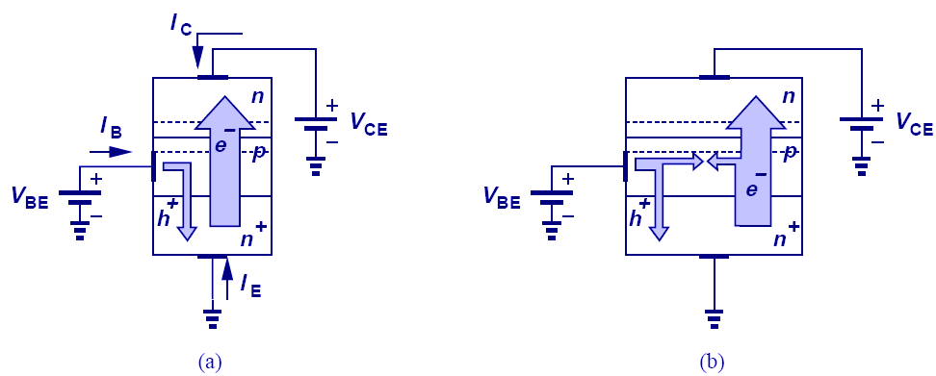
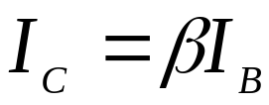
Base Current
Base current consists of two components: 1) Reverse injection of holes into the emitter and 2) recombination of holes with electrons coming from the emitter.
CH4 Physics of Bipolar Transistors

Slide 16
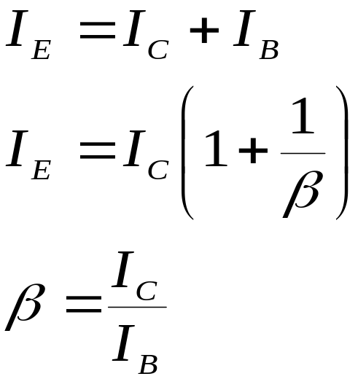
Emitter Current
Applying Kirchoff’s current law to the transistor, we can easily find the emitter current.
CH4 Physics of Bipolar Transistors

Slide 17
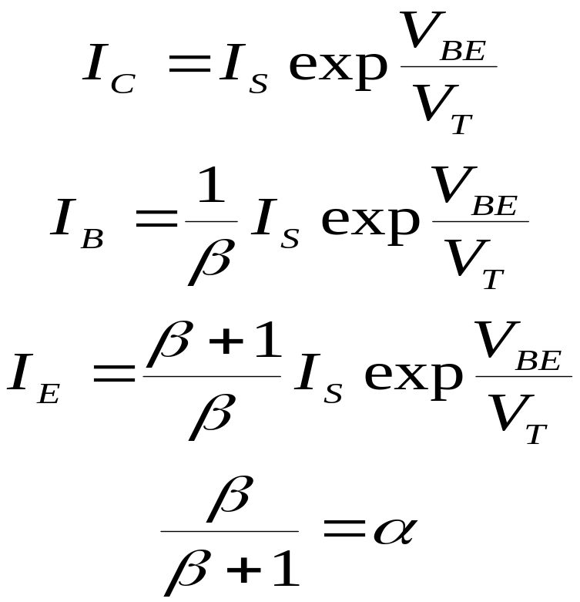
Summary of Currents
CH4 Physics of Bipolar Transistors

Slide 18
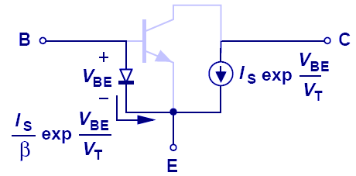
Bipolar Transistor Large Signal Model
A diode is placed between base and emitter and a voltage controlled current source is placed between the collector and emitter.
CH4 Physics of Bipolar Transistors

Slide 19
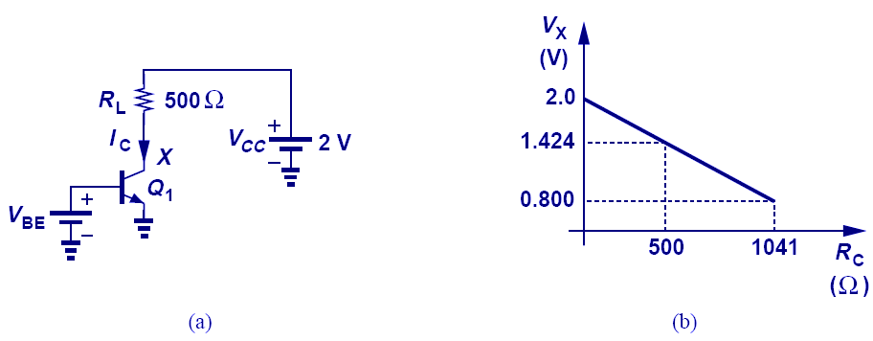
Example: Maximum R_{L}
As R_{L} increases, V_{x} drops and eventually forward biases the collector-base junction. This will force the transistor out of forward active region.
Therefore, there exists a maximum tolerable collector resistance.
CH4 Physics of Bipolar Transistors

Slide 20
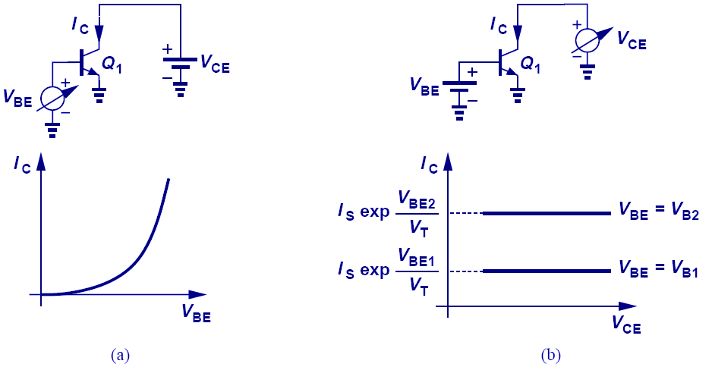
Characteristics of Bipolar Transistor
CH4 Physics of Bipolar Transistors

Slide 21
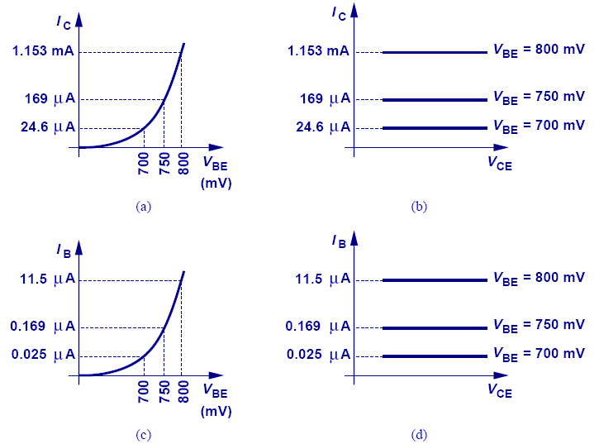
Example: IV Characteristics
CH4 Physics of Bipolar Transistors

Slide 22
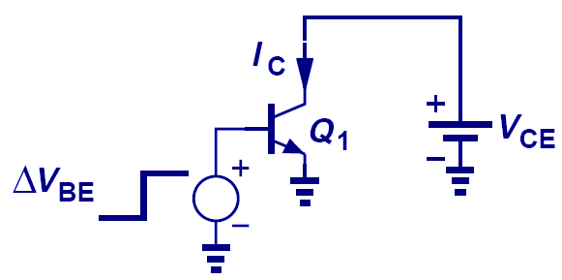
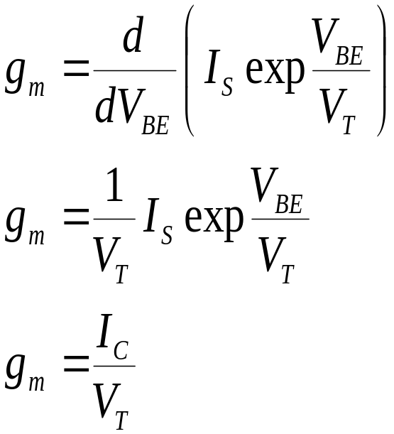
Transconductance
Transconductance, g_{m} shows a measure of how well the transistor converts voltage to current.
It will later be shown that g_{m} is one of the most important parameters in circuit design.
CH4 Physics of Bipolar Transistors

Slide 23
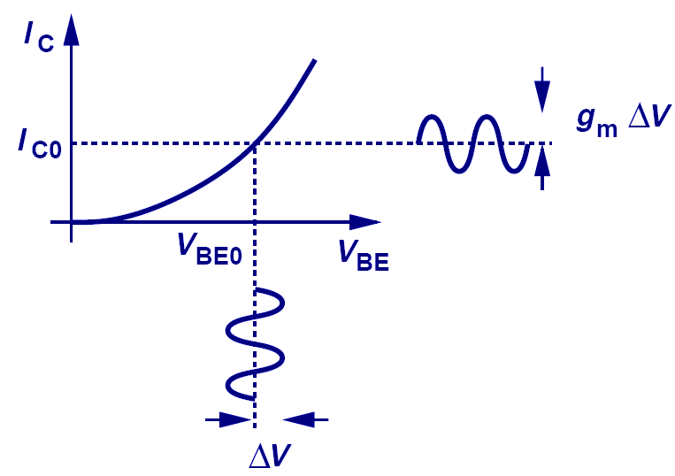
Visualization of Transconductance
g_{m} can be visualized as the slope of I_{C} versus V_{BE.}
A large I_{C} has a large slope and therefore a large g_{m.}
CH4 Physics of Bipolar Transistors

Slide 24
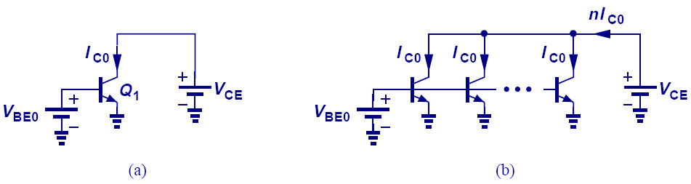
Transconductance and Area
When the area of a transistor is increased by n, I_{S} increases by n. For a constant V_{BE,} I_{C} and hence g_{m} increases by a factor of n.
CH4 Physics of Bipolar Transistors

Slide 25
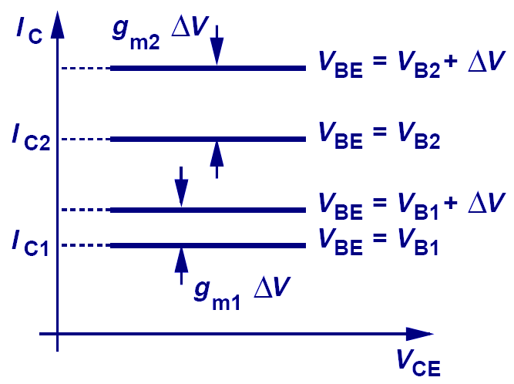
Transconductance and I_{c}
The figure above shows that for a given V_{BE} swing, the current excursion around I_{C2} is larger than it would be around I_{C1}. This is because g_{m} is larger I_{C2}.
CH4 Physics of Bipolar Transistors

Slide 26
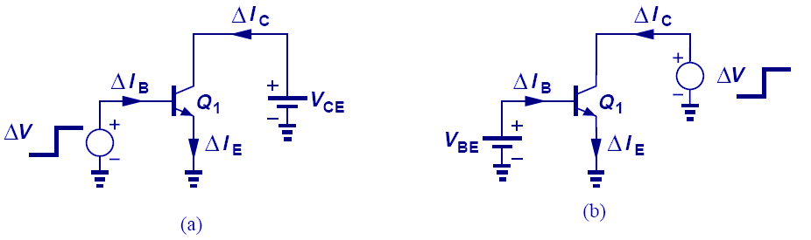
Small-Signal Model: Derivation
Small signal model is derived by perturbing voltage difference every two terminals while fixing the third terminal and analyzing the change in current of all three terminals. We then represent these changes with controlled sources or resistors.
CH4 Physics of Bipolar Transistors

Slide 27
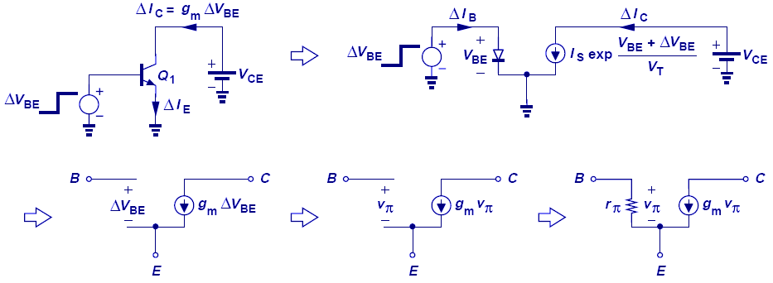
Small-Signal Model: V_{BE} Change
CH4 Physics of Bipolar Transistors

Slide 28
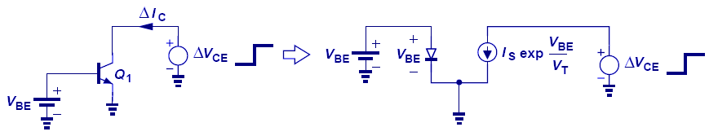
Small-Signal Model: V_{CE} Change
Ideally, V_{CE} has no effect on the collector current. Thus, it will not contribute to the small signal model.
It can be shown that V_{CB} has no effect on the small signal model, either.
CH4 Physics of Bipolar Transistors

Slide 29
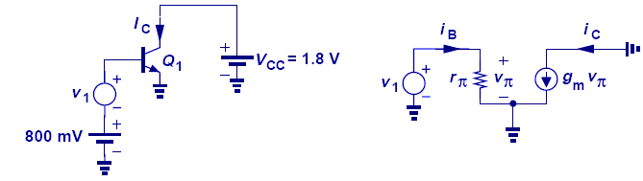
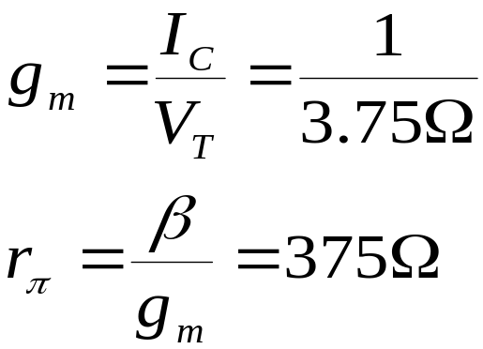
Small Signal Example I
Here, small signal parameters are calculated from DC operating point and are used to calculate the change in collector current due to a change in V_{BE}.
CH4 Physics of Bipolar Transistors

Slide 30
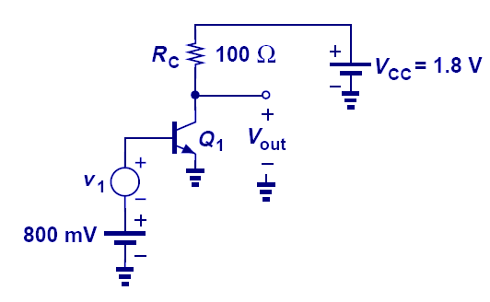
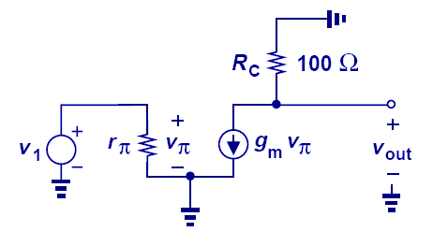
Small Signal Example II
In this example, a resistor is placed between the power supply and collector, therefore, providing an output voltage.
CH4 Physics of Bipolar Transistors

Slide 31
AC Ground
Since the power supply voltage does not vary with time, it is regarded as a ground in small-signal analysis.
CH4 Physics of Bipolar Transistors

Slide 32
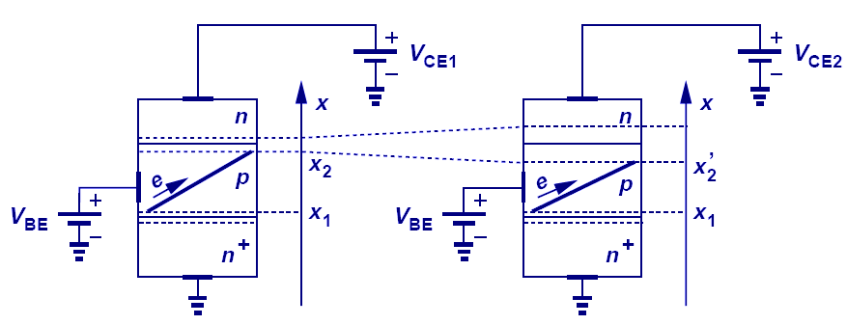
Early Effect
The claim that collector current does not depend on V_{CE} is not accurate.
As V_{CE} increases, the depletion region between base and collector increases. Therefore, the effective base width decreases, which leads to an increase in the collector current.
CH4 Physics of Bipolar Transistors

Slide 33
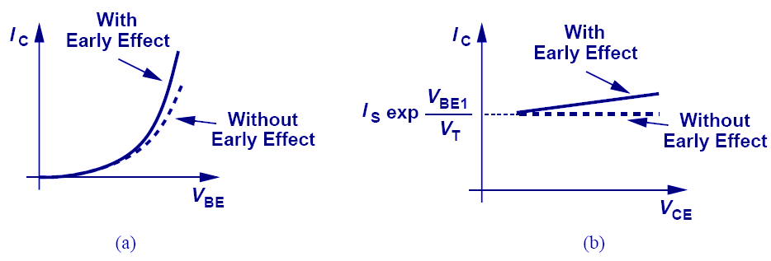
Early Effect Illustration
With Early effect, collector current becomes larger than usual and a function of V_{CE.}
CH4 Physics of Bipolar Transistors

Slide 34
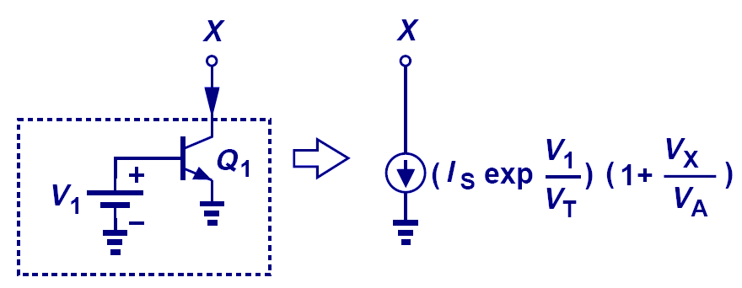
Early Effect Representation
CH4 Physics of Bipolar Transistors

Slide 35
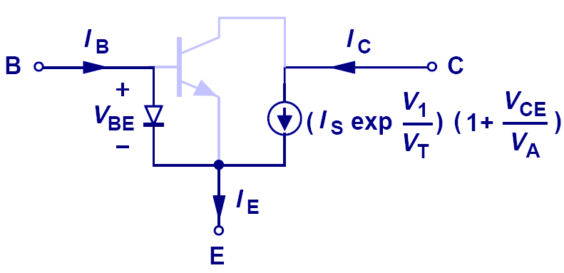
Early Effect and Large-Signal Model
Early effect can be accounted for in large-signal model by simply changing the collector current with a correction factor.
In this mode, base current does not change.
CH4 Physics of Bipolar Transistors

Slide 36
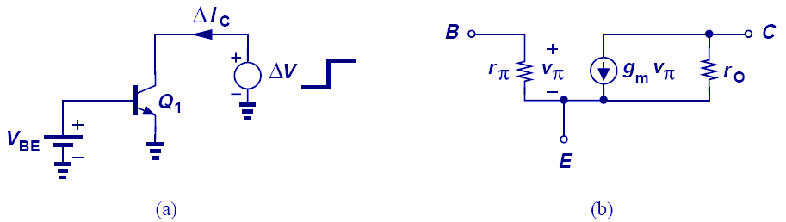
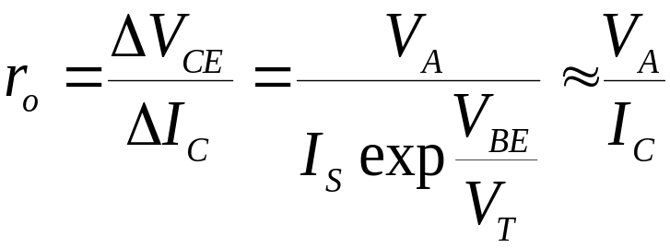
Early Effect and Small-Signal Model
CH4 Physics of Bipolar Transistors

Slide 37
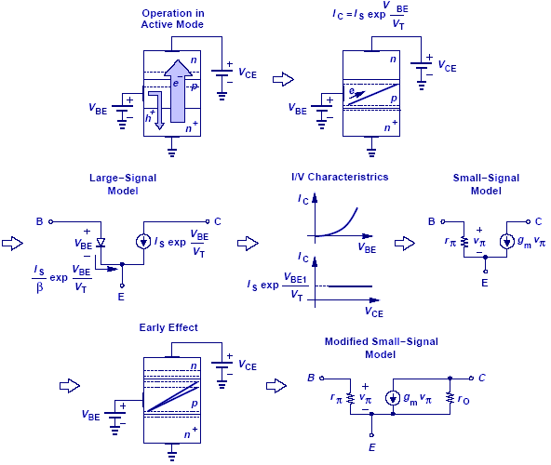
Summary of Ideas
CH4 Physics of Bipolar Transistors

Slide 38
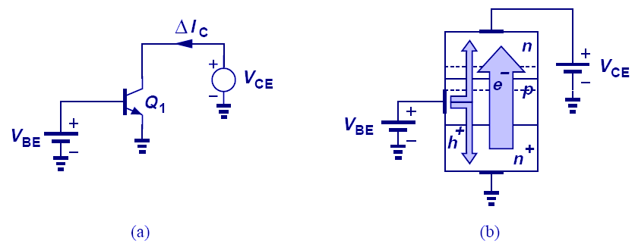
Bipolar Transistor in Saturation
When collector voltage drops below base voltage and forward biases the collector-base junction, base current increases and decreases the current gain factor, β.
CH4 Physics of Bipolar Transistors

Slide 39
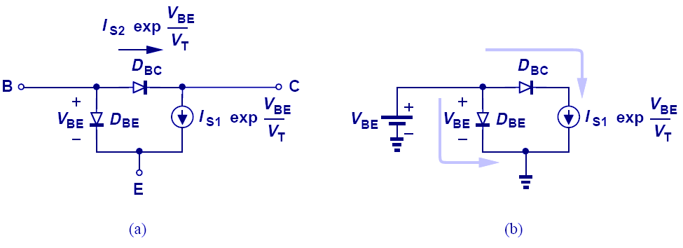
Large-Signal Model for Saturation Region
CH4 Physics of Bipolar Transistors

Slide 40
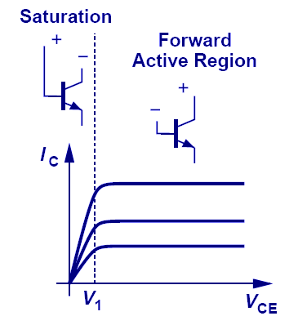
Overall I/V Characteristics
The speed of the BJT also drops in saturation.
CH4 Physics of Bipolar Transistors

Slide 41
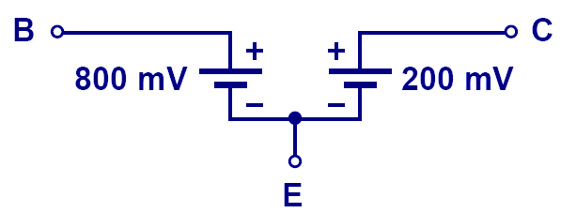
Deep Saturation
In deep saturation region, the transistor loses its voltage-controlled current capability and V_{CE} becomes constant.
CH4 Physics of Bipolar Transistors

Slide 42
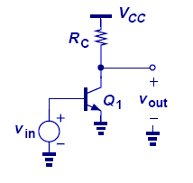
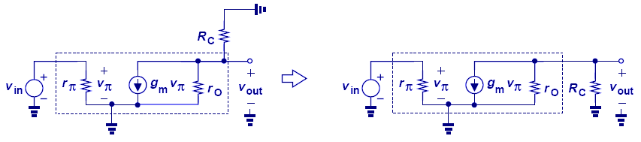
Small Signal Model Example I
CH4 Physics of Bipolar Transistors

Slide 43
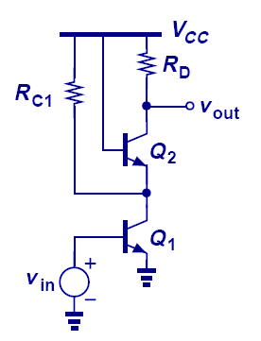
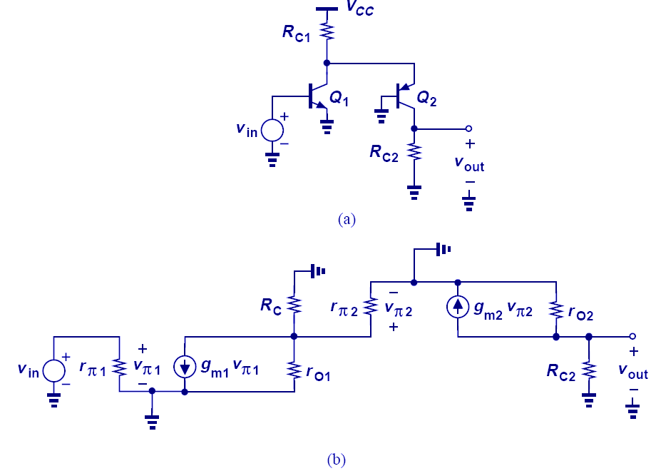
Small Signal Model Example IV
CH4 Physics of Bipolar Transistors

Slide 44
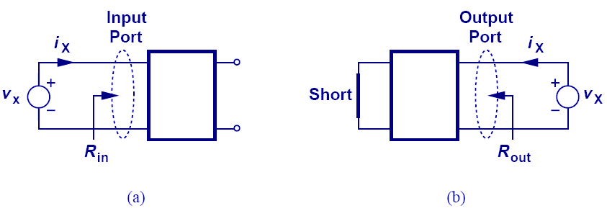
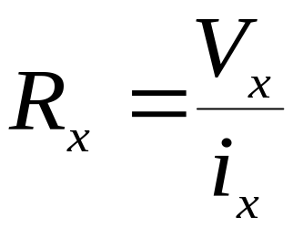
Input/Output Impedances
The figure above shows the techniques of measuring input and output impedances.
CH5 Bipolar Amplifiers

Slide 45


Input Impedance Example I
When calculating input/output impedance, small-signal analysis is assumed.
CH5 Bipolar Amplifiers

Slide 46

Impedance at a Node
When calculating I/O impedances at a port, we usually ground one terminal while applying the test source to the other terminal of interest.
CH5 Bipolar Amplifiers

Slide 47

Biasing of BJT
Transistors and circuits must be biased because (1) transistors must operate in the active region, (2) their small-signal parameters depend on the bias conditions.
CH5 Bipolar Amplifiers

Slide 48

DC Analysis vs. Small-Signal Analysis
First, DC analysis is performed to determine operating point and obtain small-signal parameters.
Second, sources are set to zero and small-signal model is used.
CH5 Bipolar Amplifiers

Slide 49

Notation Simplification
Hereafter, the battery that supplies power to the circuit is replaced by a horizontal bar labeled Vcc, and input signal is simplified as one node called V_{in.}
CH5 Bipolar Amplifiers

Slide 50


Biasing with Base Resistor
Assuming a constant value for V_{BE}, one can solve for both I_{B} and I_{C} and determine the terminal voltages of the transistor.
However, bias point is sensitive to β variations.
CH5 Bipolar Amplifiers

Slide 51
Chapter 6 Physics of MOS Transistors
6.1 Structure of MOSFET
6.2 Operation of MOSFET
6.3 MOS Device Models
6.4 PMOS Transistor
6.5 CMOS Technology
6.6 Comparison of Bipolar and CMOS Devices

Slide 52

Chapter Outline
CH 6 Physics of MOS Transistors

Slide 53

Metal-Oxide-Semiconductor (MOS) Capacitor
The MOS structure can be thought of as a parallel-plate capacitor, with the top plate being the positive plate, oxide being the dielectric, and Si substrate being the negative plate. (We are assuming P-substrate.)
CH 6 Physics of MOS Transistors

Slide 54

Structure and Symbol of MOSFET
This device is symmetric, so either of the n+ regions can be source or drain.
CH 6 Physics of MOS Transistors

Slide 55

State of the Art MOSFET Structure
The gate is formed by polysilicon, and the insulator by Silicon dioxide.
CH 6 Physics of MOS Transistors

Slide 56

Formation of Channel
First, the holes are repelled by the positive gate voltage, leaving behind negative ions and forming a depletion region. Next, electrons are attracted to the interface, creating a channel (“inversion layer”).
CH 6 Physics of MOS Transistors

Slide 57

Voltage-Dependent Resistor
The inversion channel of a MOSFET can be seen as a resistor.
Since the charge density inside the channel depends on the gate voltage, this resistance is also voltage-dependent.
CH 6 Physics of MOS Transistors

Slide 58

Voltage-Controlled Attenuator
As the gate voltage decreases, the output drops because the channel resistance increases.
This type of gain control finds application in cell phones to avoid saturation near base stations.
CH 6 Physics of MOS Transistors

Slide 59

MOSFET Characteristics
The MOS characteristics are measured by varying V_{G} while keeping V_{D} constant, and varying V_{D} while keeping V_{G} constant.
(d) shows the voltage dependence of channel resistance.
CH 6 Physics of MOS Transistors

Slide 60

L and t_{ox} Dependence
Small gate length and oxide thickness yield low channel resistance, which will increase the drain current.
CH 6 Physics of MOS Transistors

Slide 61

Effect of W
As the gate width increases, the current increases due to a decrease in resistance. However, gate capacitance also increases thus, limiting the speed of the circuit.
An increase in W can be seen as two devices in parallel.
CH 6 Physics of MOS Transistors

Slide 62

Channel Potential Variation
Since there’s a channel resistance between drain and source, and if drain is biased higher than the source, channel potential increases from source to drain, and the potential between gate and channel will decrease from source to drain.
CH 6 Physics of MOS Transistors

Slide 63

Channel Pinch-Off
As the potential difference between drain and gate becomes more positive, the inversion layer beneath the interface starts to pinch off around drain.
When V_{D} – V_{G} = V_{th}, the channel at drain totally pinches off, and when V_{D} – V_{G} > V_{th}, the channel length starts to decrease.
CH 6 Physics of MOS Transistors

Slide 64


Channel Charge Density
The channel charge density is equal to the gate capacitance times the gate voltage in excess of the threshold voltage.
CH 6 Physics of MOS Transistors

Slide 65


Charge Density at a Point
Let x be a point along the channel from source to drain, and V(x) its potential; the expression above gives the charge density (per unit length).
CH 6 Physics of MOS Transistors

Slide 66


Charge Density and Current
The current that flows from source to drain (electrons) is related to the charge density in the channel by the charge velocity.
CH 6 Physics of MOS Transistors

Slide 67

Drain Current
CH 6 Physics of MOS Transistors

Slide 68

Parabolic I_{D}-V_{DS} Relationship
By keeping V_{G} constant and varying V_{DS}, we obtain a parabolic relationship.
The maximum current occurs when V_{DS} equals to V_{GS}- V_{TH}.
CH 6 Physics of MOS Transistors

Slide 69


I_{D}-V_{DS} for Different Values of V_{GS}
CH 6 Physics of MOS Transistors

Slide 70


Linear Resistance
At small V_{DS}, the transistor can be viewed as a resistor, with the resistance depending on the gate voltage.
It finds application as an electronic switch.
CH 6 Physics of MOS Transistors

Slide 71

Different Regions of Operation
CH 6 Physics of MOS Transistors

Slide 72

How to Determine ‘Region of Operation’
When the potential difference between gate and drain is greater than V_{TH}, the MOSFET is in triode region.
When the potential difference between gate and drain becomes equal to or less than V_{TH}, the MOSFET enters saturation region.
CH 6 Physics of MOS Transistors

Slide 73

Triode or Saturation?
When the region of operation is not known, a region is assumed (with an intelligent guess). Then, the final answer is checked against the assumption.
CH 6 Physics of MOS Transistors

Slide 74


Channel-Length Modulation
The original observation that the current is constant in the saturation region is not quite correct. The end point of the channel actually moves toward the source as V_{D} increases, increasing I_{D}. Therefore, the current in the saturation region is a weak function of the drain voltage.
CH 6 Physics of MOS Transistors

Slide 75

λ and L
Unlike the Early voltage in BJT, the channel- length modulation factor can be controlled by the circuit designer.
For long L, the channel-length modulation effect is less than that of short L.
CH 6 Physics of MOS Transistors

Slide 76




Transconductance
Transconductance is a measure of how strong the drain current changes when the gate voltage changes.
It has three different expressions.
CH 6 Physics of MOS Transistors

Slide 77

Large-Signal Models
Based on the value of V_{DS,} MOSFET can be represented with different large-signal models.
CH 6 Physics of MOS Transistors

Slide 78


Small-Signal Model
When the bias point is not perturbed significantly, small-signal model can be used to facilitate calculations.
To represent channel-length modulation, an output resistance is inserted into the model.
CH 6 Physics of MOS Transistors

Slide 79

CMOS Technology
It possible to grow an n-well inside a p-substrate to create a technology where both NMOS and PMOS can coexist.
It is known as CMOS, or “Complementary MOS”.
CH 6 Physics of MOS Transistors

Slide 80

Comparison of Bipolar and MOS Transistors
Bipolar devices have a higher g_{m} than MOSFETs for a given bias current due to its exponential IV characteristics.
CH 6 Physics of MOS Transistors

